Slide 1
Lecture 07 Abstract Data Type Stack and Queue (Array-based Implementation]
CSE225: Data Structures and Algorithms

Slide 2


Stack
A list
Data items can be added and deleted
Maintains Last In First Out (LIFO) order

Slide 3
Specification of StackType
Structure: | Elements are added to and removed from the top of the stack.
Definitions (provided by user):
MAX_ITEMS | Maximum number of items that might be on the stack.
ItemType | Data type of the items on the stack.
Operations (provided by the ADT):
MakeEmpty
Function | Sets stack to an empty state.
Postcondition | Stack is empty.
Boolean IsEmpty
Function | Determines whether the stack is empty.
Precondition | Stack has been initialized.
Postcondition | Returns true if stack is empty and false otherwise.
Boolean IsFull
Function | Determines whether the stack is full.
Precondition | Stack has been initialized.
Postcondition | Returns true if stack is full and false otherwise.

Slide 4
Specification of StackType
Push(ItemType newItem)
Function | Adds newItem to the top of the stack.
Precondition | Stack has been initialized.
Postcondition | If (stack is full), exception FullStack is thrown, else newItem is at the top of the stack.
Pop()
Function | Removes top item from the stack.
Precondition | Stack has been initialized.
Postcondition | If (stack is empty), exception EmptyStack is thrown, else top element has been removed from stack.
ItemType Top()
Function | Returns a copy of the top item on the stack.
Precondition | Stack has been initialized.
Postcondition | If (stack is empty), exception EmptyStack is thrown, else a copy of the top element is returned.

Slide 5
stacktype.h
#ifndef STACKTYPE_H_INCLUDED
#define STACKTYPE_H_INCLUDED
const int MAX_ITEMS = 5;
class FullStack
{}; // Exception class thrown by Push when stack is full.
class EmptyStack
{}; // Exception class thrown by Pop and Top when stack is empty.
template <class ItemType>
class StackType
{
public:
StackType();
bool IsFull();
bool IsEmpty();
void MakeEmpty();
void Push(ItemType);
void Pop();
ItemType Top();
private:
int top;
ItemType items[MAX_ITEMS];
};
#endif // STACKTYPE_H_INCLUDED

Slide 6
stacktype.cpp
#include "StackType.h"
template <class ItemType>
StackType<ItemType>::StackType()
{
top = -1;
}
template <class ItemType>
bool StackType<ItemType>::IsEmpty()
{
return (top == -1);
}
void StackType<ItemType>::MakeEmpty()
{
top = -1;
}
template <class ItemType>
bool StackType<ItemType>::IsFull()
{
return (top == MAX_ITEMS-1);
}
template <class ItemType>
void StackType<ItemType>::Push(ItemType newItem)
{
if( IsFull() )
throw FullStack();
top++;
items[top] = newItem;
}
template <class ItemType>
void StackType<ItemType>::Pop()
{
if( IsEmpty() )
throw EmptyStack();
top--;
}
template <class ItemType>
ItemType StackType<ItemType>::Top()
{
if (IsEmpty())
throw EmptyStack();
return items[top];
}

Slide 7
stacktype.cpp
#include "StackType.h"
template <class ItemType>
StackType<ItemType>::StackType()
{
top = -1;
}
template <class ItemType>
bool StackType<ItemType>::IsEmpty()
{
return (top == -1);
}
void StackType<ItemType>::MakeEmpty()
{
top = -1;
}
template <class ItemType>
bool StackType<ItemType>::IsFull()
{
return (top == MAX_ITEMS-1);
}
template <class ItemType>
void StackType<ItemType>::Push(ItemType newItem)
{
if( IsFull() )
throw FullStack();
top++;
items[top] = newItem;
}
template <class ItemType>
void StackType<ItemType>::Pop()
{
if( IsEmpty() )
throw EmptyStack();
top--;
}
template <class ItemType>
ItemType StackType<ItemType>::Top()
{
if (IsEmpty())
throw EmptyStack();
return items[top];
}
O(1)
O(1)
O(1)
O(1)
O(1)
O(1)
O(1)

Slide 8
Application of Stack
()
(())()(()())()
(())()((()
(())))((()
Which of the strings of parentheses are balanced?

Slide 9
Application of Stack
Algorithm for matching parentheses string
Initialise an empty stack
Read next item in the string
If item is an opening parentheses, push it into the stack
Else, if item is a closing parentheses, pop from stack
If there are more items to process, go to step 2
Pop the answer off the stack.

Slide 10
Application of Stack
(())()(()())()

Slide 11
Application of Stack
(())()(()())()
string
( | ( | ) | ) | ( | ) | ( | ( | ) | ( | ) | ) | ( | )
stack

Slide 12
Application of Stack
string
( | ( | ) | ) | ( | ) | ( | ( | ) | ( | ) | ) | ( | )
stack
(

Slide 13
Application of Stack
string
( | ( | ) | ) | ( | ) | ( | ( | ) | ( | ) | ) | ( | )
stack
( | (

Slide 14
Application of Stack
string
( | ( | ) | ) | ( | ) | ( | ( | ) | ( | ) | ) | ( | )
stack
(

Slide 15
Application of Stack
string
( | ( | ) | ) | ( | ) | ( | ( | ) | ( | ) | ) | ( | )
stack

Slide 16
Application of Stack
string
( | ( | ) | ) | ( | ) | ( | ( | ) | ( | ) | ) | ( | )
stack
(

Slide 17
Application of Stack
string
( | ( | ) | ) | ( | ) | ( | ( | ) | ( | ) | ) | ( | )
stack

Slide 18
Application of Stack
string
( | ( | ) | ) | ( | ) | ( | ( | ) | ( | ) | ) | ( | )
stack
(

Slide 19
Application of Stack
string
( | ( | ) | ) | ( | ) | ( | ( | ) | ( | ) | ) | ( | )
stack
( | (

Slide 20
Application of Stack
string
( | ( | ) | ) | ( | ) | ( | ( | ) | ( | ) | ) | ( | )
stack
(

Slide 21
Application of Stack
string
( | ( | ) | ) | ( | ) | ( | ( | ) | ( | ) | ) | ( | )
stack
( | (

Slide 22
Application of Stack
string
( | ( | ) | ) | ( | ) | ( | ( | ) | ( | ) | ) | ( | )
stack
(

Slide 23
Application of Stack
string
( | ( | ) | ) | ( | ) | ( | ( | ) | ( | ) | ) | ( | )
stack

Slide 24
Application of Stack
string
( | ( | ) | ) | ( | ) | ( | ( | ) | ( | ) | ) | ( | )
stack
(

Slide 25
Application of Stack
string
( | ( | ) | ) | ( | ) | ( | ( | ) | ( | ) | ) | ( | )
stack

Slide 26
Application of Stack
string
( | ( | ) | ) | ( | ) | ( | ( | ) | ( | ) | ) | ( | )
stack
empty stack
Indicates balanced string of parentheses

Slide 27
Application of Stack
(())()((()
Consider this string. After processing each item, the stack is not empty.
stack
( | (
non-empty stack
Indicates unbalanced string of parentheses

Slide 28
Application of Stack
(())))((()
Consider this string. When processing indicated item, you are trying to pop from empty stack.
stack
unsuccessful pop
Indicates unbalanced string of parentheses

Slide 29

Queue
A list
Data items can be added and deleted
Maintains First In First Out (FIFO) order

Slide 30
Specification of QueueType
Structure: | Elements are added to the rear and removed from the front of the queue.
Definitions (provided by user):
MAX_ITEMS | Maximum number of items that might be on the queue.
ItemType | Data type of the items on the queue.
Operations (provided by the ADT):
MakeEmpty
Function | Sets queue to an empty state.
Postcondition | Queue is empty.
Boolean IsEmpty
Function | Determines whether the queue is empty.
Precondition | Queue has been initialized.
Postcondition | Returns true if queue is empty and false otherwise.
Boolean IsFull
Function | Determines whether the queue is full.
Precondition | Queue has been initialized.
Postcondition | Returns true if queue is full and false otherwise.

Slide 31
Specification of QueueType
Enqueue(ItemType newItem)
Function | Adds newItem to the rear of the queue.
Precondition | Queue has been initialized.
Post-condition | If (queue is full), Full Queue exception is thrown, else newItem is at rear of queue.
Dequeue(ItemType& item)
Function | Removes front item from the queue and returns it in item.
Precondition | Queue has been initialized.
Postcondition | If (queue is empty), Empty Queue exception is thrown and item is undefined, else front element has been removed from queue and item is a copy of removed element.

Slide 32
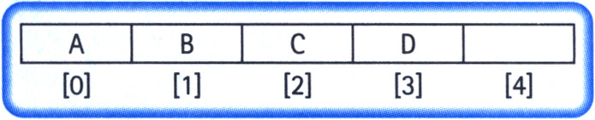
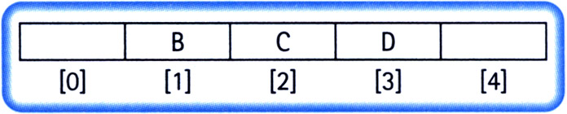
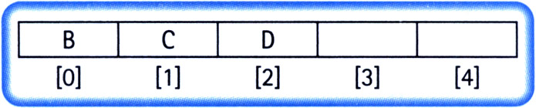
Implementation Issues
Always insert elements at the back of the array.

Slide 33
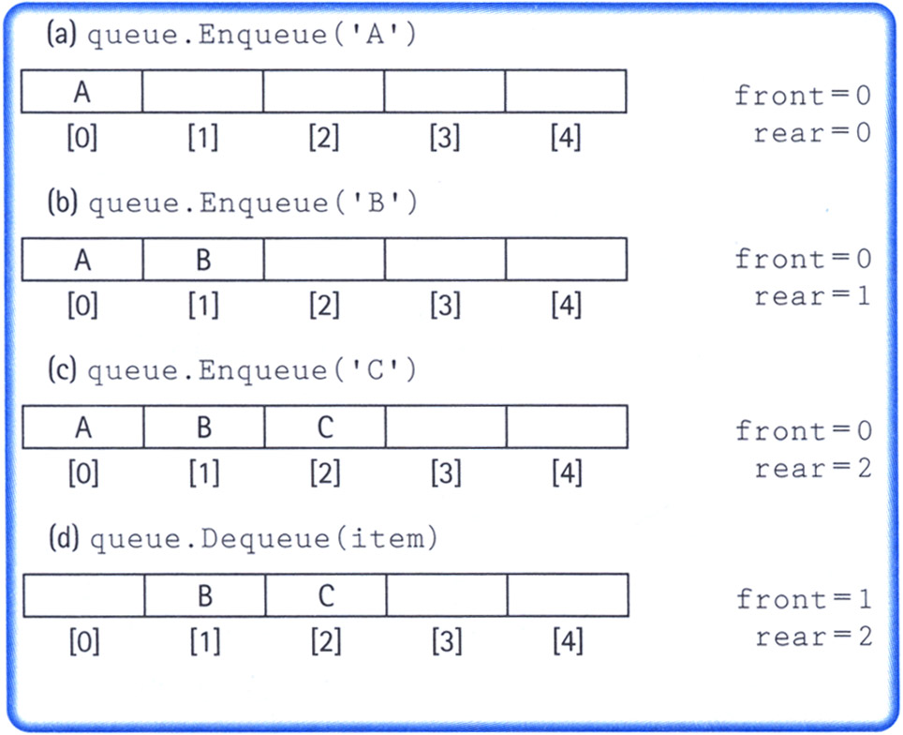
Implementation Issues
Maintain two indices: front and rear
Increment the indices as additions and deletions are performed (rear++ for addition and front++ for deletion)
Dead space

Slide 34
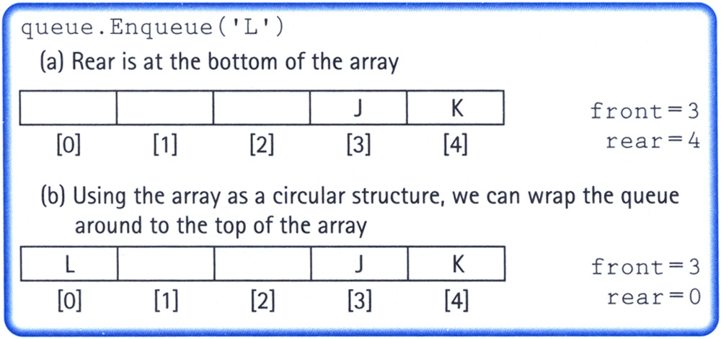
Implementation Issues
Maintain two indices: front and rear
Make the indices “wrap around” when they reach the end of the array
rear = (rear + 1) % maxQue; //maxQue=size of array
front = (front + 1) % maxQue;

Slide 35
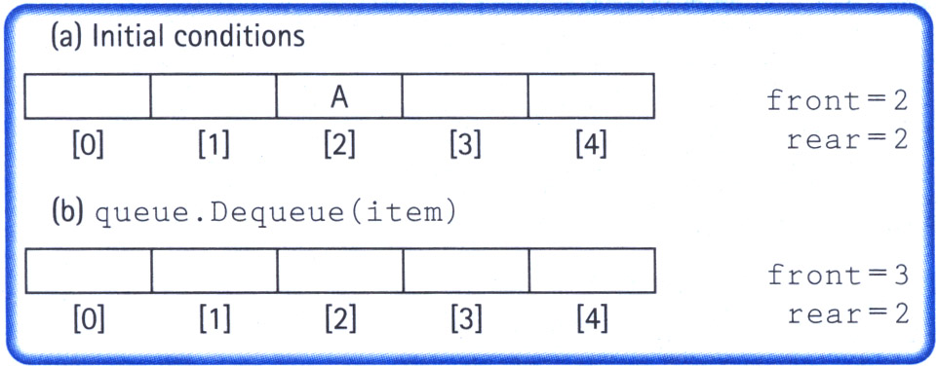
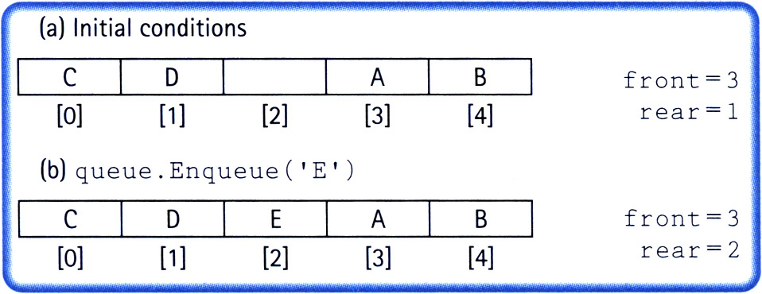
Implementation Issues
How do we differentiate between the empty state and the full state?

Slide 36
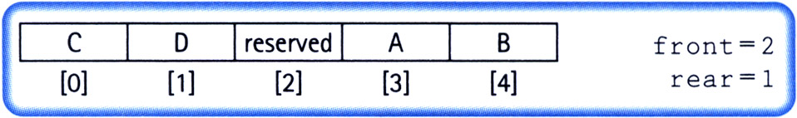
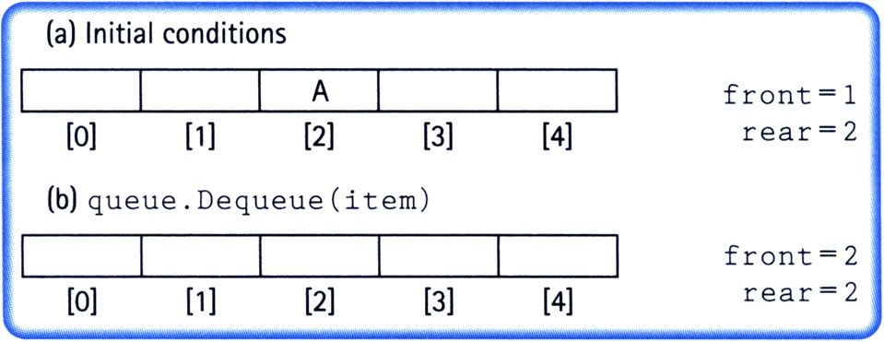
Implementation Issues
Let front indicate the index of the array slot preceding the front element.
The array slot preceding the front element is reserved and items are not assigned in that slot.

Slide 37
Implementation Issues
Full queue when (rear + 1) % maxQue == front
Empty queue when front == rear

Slide 38
queuetype.h
typedef char ItemType;
class FullQueue
{};
class EmptyQueue
{};
class QueType
{
public:
QueType();
QueType(int max);
~QueType();
void MakeEmpty();
bool IsEmpty();
bool IsFull();
void Enqueue(ItemType newItem);
void Dequeue(ItemType& item);
private:
int front;
int rear;
ItemType* items;
int maxQue;
};

Slide 39
queuetype.cpp
#include "QueType.h"
QueType::QueType(int max)
{
maxQue = max + 1;
front = maxQue - 1;
rear = maxQue - 1;
items = new ItemType[maxQue];
}
QueType::QueType()
{
maxQue = 501;
front = maxQue - 1;
rear = maxQue - 1;
items = new ItemType[maxQue];
}
QueType::~QueType()
{
delete [] items;
}
void QueType::MakeEmpty()
{
front = maxQue - 1;
rear = maxQue - 1;
}
bool QueType::IsEmpty()
{
return (rear == front);
}
bool QueType::IsFull()
{
return ((rear+1)%maxQue == front);
}

Slide 40
queuetype.cpp
void QueType::Enqueue(ItemType newItem)
{
if (IsFull())
throw FullQueue();
else
{
rear = (rear +1) % maxQue;
items[rear] = newItem;
}
}
void QueType::Dequeue(ItemType& item)
{
if (IsEmpty())
throw EmptyQueue();
else
{
front = (front + 1) % maxQue;
item = items[front];
}
}

Slide 41
queuetype.cpp
#include "QueType.h"
QueType::QueType(int max)
{
maxQue = max + 1;
front = maxQue - 1;
rear = maxQue - 1;
items = new ItemType[maxQue];
}
QueType::QueType()
{
maxQue = 501;
front = maxQue - 1;
rear = maxQue - 1;
items = new ItemType[maxQue];
}
QueType::~QueType()
{
delete [] items;
}
void QueType::MakeEmpty()
{
front = maxQue - 1;
rear = maxQue - 1;
}
bool QueType::IsEmpty()
{
return (rear == front);
}
bool QueType::IsFull()
{
return ((rear+1)%maxQue == front);
}
O(1)
O(1)
O(1)
O(1)
O(1)
O(1)

Slide 42
queuetype.cpp
void QueType::Enqueue(ItemType newItem)
{
if (IsFull())
throw FullQueue();
else
{
rear = (rear +1) % maxQue;
items[rear] = newItem;
}
}
void QueType::Dequeue(ItemType& item)
{
if (IsEmpty())
throw EmptyQueue();
else
{
front = (front + 1) % maxQue;
item = items[front];
}
}
O(1)
O(1)

